Slide 1



Quizzes
No Quizzes
Dependent Variable
Final Exam
(Learning Measurement)

Slide 2
Independent Variable:
Quiz or No Quiz
Quizzes
No Quizzes
Dependent Variable
Final Exam
(Learning Measurement)

Slide 3
Quizzes
IV
No Quizzes
DV
Hypothesis: Taking quizzes leads to better learning in the classroom

Slide 4
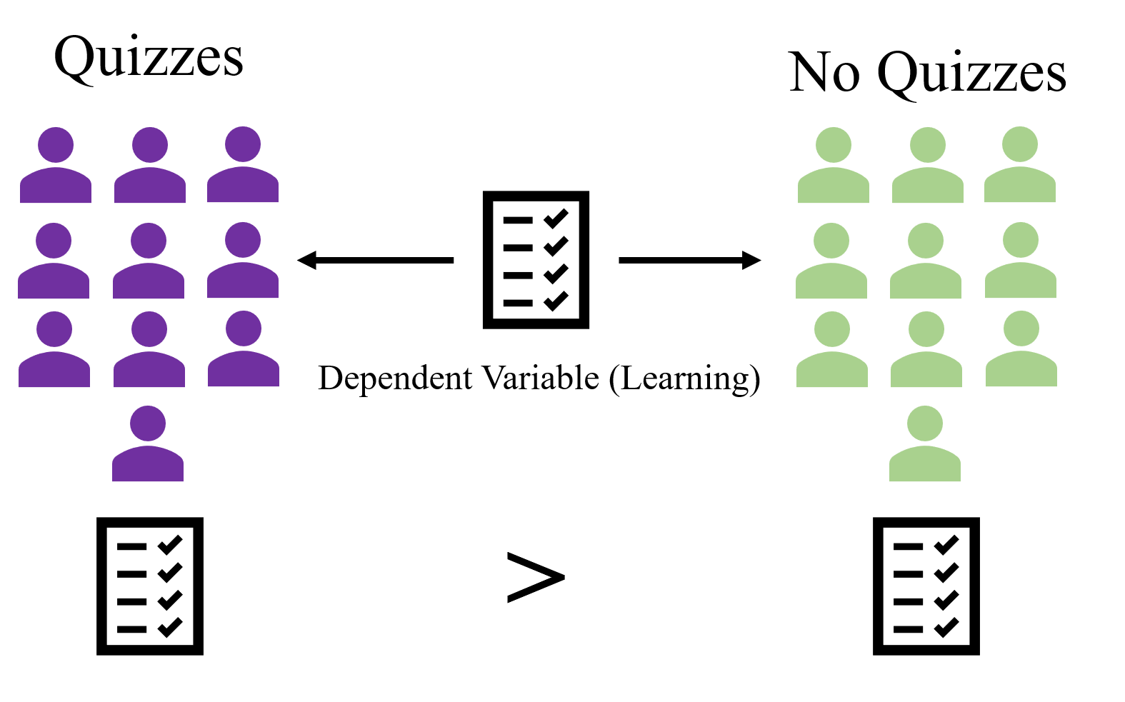

Slide 5
Hypothesis:
A prediction regarding the outcome
of a study

Slide 6



Hypothesis:
A prediction regarding the outcome of a study

Slide 7





Slide 10
Theory:
Organized system of assumptions that try to explain some phenomenon

Slide 11
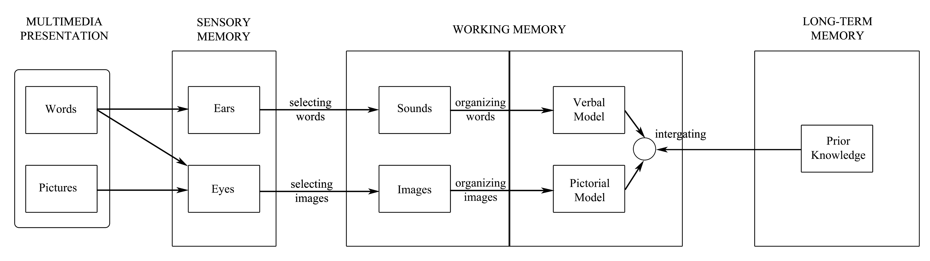
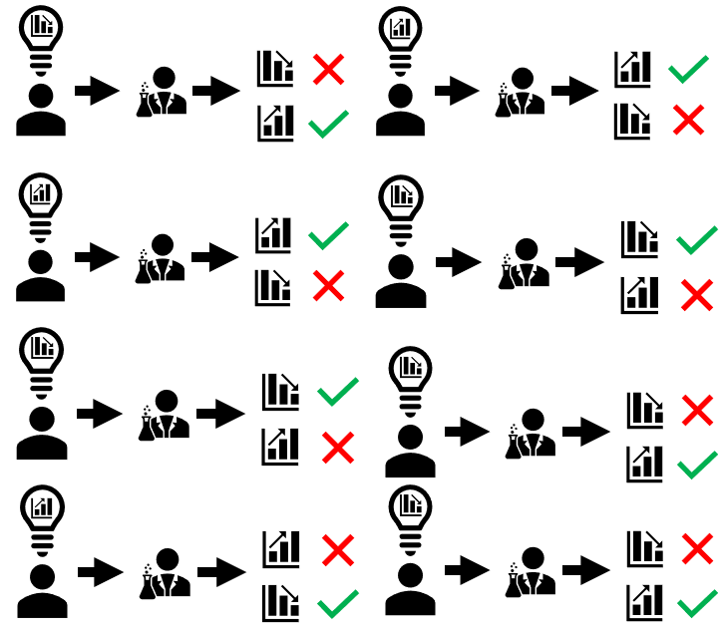
Theory:
Organized system of assumptions that try to explain some phenomenon

Slide 12
Theory:
Organized system of assumptions that try to explain some phenomenon

Slide 13
Pseudoscience:
Claims that appear scientific but violate some important criteria for science

Slide 14
Dependent Variables:
Reliable
Accurate
Precise

Slide 15
Precise:
A measurement that uses units that are small enough for what you are studying.

Slide 16
Accuracy:
Measurement that gives the true value of something.

Slide 17


15 lbs
30

Slide 19



Slide 20
65
74
70
70

Slide 21
Dependent Variables:
Must be able to measure real differences that exist between groups

Slide 22
Dependent Variables:
Must be able to measure real differences that exist between groups
Reliable - Provides consistent measurements

Slide 23
Dependent Variables:
Must be able to measure real differences that exist between groups
Reliable - Provides consistent measurements
Accurate - Close as possible to “true value”

Slide 24
Dependent Variables:
Must be able to measure real differences that exist between groups
Reliable - Provides consistent measurements
Accurate - Close as possible to “true value”
Precise - Use small enough units

Slide 25
Constructive Validity
Construct: attribute or ability such as aggression, smart, friendly, good math skills

Slide 26
Constructive Validity:
the extent to which researchers are measuring a construct that they claim to be measuring.

Slide 27



# Friends
Friendliness:
Or…

Slide 28
# Friends
Making friends
Friendliness:
Or…

Slide 29
Chemistry Class
Dependent Variable
Final Test on History

Slide 30
Chemistry Class
Dependent Variable
Final Test on History
Poor Construct Validity

Slide 31
Predictive Validity

Slide 32
Good Predictive Validity
Can predict some future performance

Slide 33

Predictive Validity
1st Yr.
2nd Yr.
ACT Score
SAT Score
4.0 GPA
3.0 GPA
3rd Yr.
4th Yr.
2.6 GPA
2.4 GPA

Slide 34
ACT Score
SAT Score
1st Yr.
2nd Yr.
3rd Yr.
4th Yr.
4.0 GPA
3.0 GPA
2.0 GPA
2.1 GPA
ACT & SAT More Predictive
ACT & SAT Less Predictive

Slide 35
Face Validity

Slide 37

Good Face Validity & Good Predictive Validity
Test on Mechanics
Mechanical Ability

Slide 38
Poor Face Validity & Good Predictive Validity
Test on Geometry
Mechanical Ability

Slide 39
Validity:
Construct – Measure what you’re interested in

Slide 40
Objective Measuring
2 + 2 = 4
2 + 2 = 5

Slide 41
Student 1 Argument A 4/10
Student 2 Argument B 10/10
Experimenter 1
Student 1 Argument A 9/10
Student 2 Argument B 3/10
Experimenter 2

Slide 42
Objective Measuring
Student 1 Argument A
9/10
Student 2 Argument B
10/10
American Lit Grading Rubric
Logically connects ideas
Makes references to relevant writings
Correct grammar
….
….
….
Experimenter 1
Student 1 Argument A
9/10
Student 2 Argument B
10/10
Experimenter 2

Slide 43
Experimenter Bias

Slide 44
Experimenter
Survey:
Opinions of Politicians Green & Purple

Slide 45
Survey:
Describe how you feel about Politician Purple?
Describe how you feel about Politician Green?

Slide 46
Political Opinion Survey Data
Participant # | Positive Towards Green | Negative Towards Green | Positive Towards Purple | Negative Towards Purple
Participant 1 | 1 | 0 | 3 | 10
Participant 2 | 0 | 10 | 10 | 0
Participant 3 | 0 | 9 | 8 | 0

Slide 47
Political Opinion Survey Data
Participant # | Positive Towards Green | Negative Towards Green | Positive Towards Purple | Negative Towards Purple
Participant 1 | 1 | 0 | 3 | 10
Participant 2 | 0 | 10 | 10 | 0
Participant 3 | 0 | 9 | 8 | 0

Slide 49
“Skipping sleep one night causes students to get bad grades”

Slide 50
“Skipping sleep one night causes students to get bad grades”
What’s wrong with this conclusion?

Slide 51
Experimenter Bias

Slide 52
Experimenter Bias
The ways an experimenter can unknowingly alter the response from any participant in a study.

Slide 53

Cheeracilin
Sugar Pill (Placebo)

Slide 54

Cheeracilin
Sugar Pill (Placebo)

Slide 55

Cheeracilin
Sugar Pill (Placebo)

Slide 56
1
1
1
1
1
1
1
1
1
1
1
1
1
1
1
1
1
1
1
1
1
1
1
1
1
1
A
A
A
A
A
A
A
A
A
A
A
A
A
A
A
A
A
A
A
A
A
A
A
A
A
A
Study Administrator
Experimenter

Slide 57
Subject Bias

Slide 58


Slide 59
Quiz Group
No Quiz Group

Slide 60


Quiz Group
No Quiz Group

Slide 61
Subject Bias: Self-Selection
Quiz Group
No Quiz Group

Slide 62
Butterflies Are Not Free
JACKSONVILLE -- Butterflies are beautiful creatures who some believe personify the soul. In Chinese mythology, two butterflies flying together represent love. In Japan, a swarm of them signify a bad omen.
In the United States, they represent big bucks. Wedding planners are buying butterflies by the thousands so that newly married couples can witness thousands filling the sky as they say their vows. Wealthy home owners buy them to fill their gardens. Butterflies are becoming an industry to themselves.
But, there is a problem. That is, although butterflies grow on trees, many desirable species are in low supply. Here enters Jim Cowan, a high school biology teacher in Florida. Mr. Cowan used his biology class to test whether planting several sweet pepperbrush shrubs in a 20 mile area near his school would attract butterflies and keep them in the area.
“These shrubs were going to be planted by the park district anyway so I thought I would test whether they would increase the butterfly population in the area,” explained Cowan. “If they did, then the kids would be happy knowing that they would have butterflies in their near future and even at their weddings.”
At the beginning of the semester (1 month before the shrubs were planted) his class placed insect friendly traps throughout the area. Food and water were placed inside of the traps to keep the insects alive. Students working in teams recorded the number of trapped butterflies at weekly intervals. They were careful not to touch the butterflies or mark them in any way so they would not disturb them. Weekly recordings continued after a whopping 10,000 shrubs were planted in the park, and they ended at the completion of the semester, about 2 months later.
“However, something occurred in the middle of the semester that did not ensure butterflies in the students’ future other than in their stomachs. We experienced a devastating drought coupled with high temperatures. It only lasted a week, but it adversely affected the health of the plants in the areas. Many of the pepperbrush shrubs died,” Cowan lamented.
Fortunately, the study did not die out like the shrubs. “It appears that the butterflies in fact must have been attracted to the shrubs because when the shrubs died out, so did the butterfly population. There was a huge statistically significant drop in the number of butterflies before and after the drought,” revealed Cowan.
Cowan is so excited about his discovery that pepperbrush shrubs attract butterflies that he plans to raise butterflies at his uncle’s farm and sell them to nearby wedding planners.

Slide 63
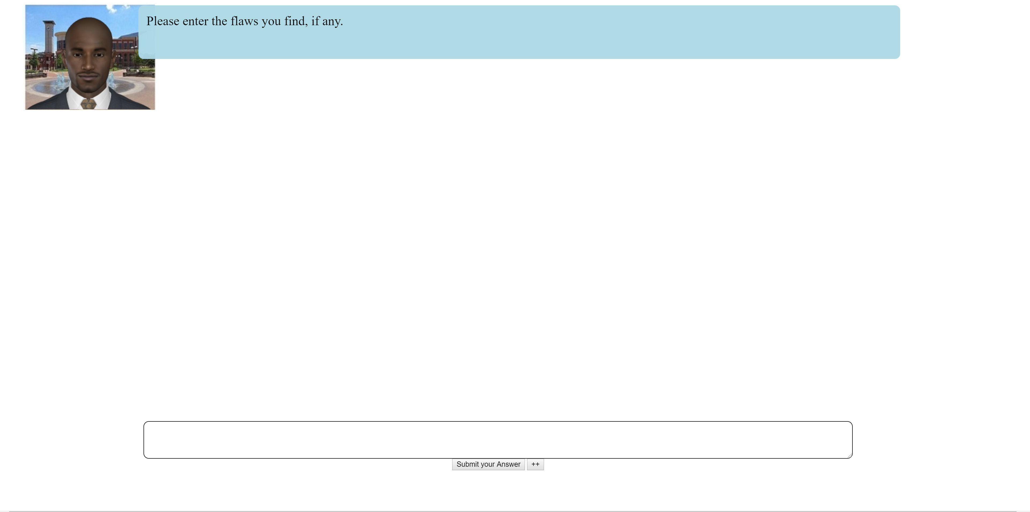
Heavy Metal Music: A Teenager’s Perspective
Like a lot of other kids my age, I like to listen to heavy metal music. Like a lot of other parents, mine complain about the type of music I listen to all the time. They think that my listening to heavy metal music is going to make me sad and depressed. I always tell them they’re wrong-my friends and I all listen to heavy metal music, and we are some of the happiest people I know!
I knew that the only way to get them to back off was to prove to them that they were wrong, so I did some research. I found the one and only article that seems to be out there about the effects of heavy metal music on mood.
In this study, 80 participants were randomly put into one of two groups. In one group, the participants were told that they could not listen to heavy metal music for one whole month. In the other group, the participants had to listen to heavy metal music for two hours every day for a month.
After the month was over, everyone had to fill out a survey with a lot of different rating questions. There were so many different questions that no one who participated could have guessed that depression was being studied.
The main question that the researchers were interested in was how the participants rated their anxiety/emotional level. So the key question was “What is your current emotional state,” and the participants answered by circling either “anxious” or “not anxious.” The researchers were unaware of which condition the participants were in when they did the final data analyses.
The researchers found that 60% of the participants who listened to heavy metal music reported feeling anxious, as did 58% of the participants who did not listen to the music at all. This was not a statistically significant difference.
So, what does all this mean for me? Well, it means that even though my parents admitted to me that I was right-I’m not going to become depressed from listening to heavy metal music-they still don’t want me to listen to it. But, the take-home message for all the other teens and their parents out there is this: Listening to heavy metal music is not going to lead to depression, so listen to it as much as you like!

Slide 64
Heavy Metal Music: A Teenager’s Perspective
Like a lot of other kids my age, I like to listen to heavy metal music. Like a lot of other parents, mine complain about the type of music I listen to all the time. They think that my listening to heavy metal music is going to make me sad and depressed. I always tell them they’re wrong-my friends and I all listen to heavy metal music, and we are some of the happiest people I know! I knew that the only way to get them to back off was to prove to them that they were wrong, so I did some research. I found the one and only article that seems to be out there about the effects of heavy metal music on mood.
In this study, 80 participants were randomly put into one of two groups. In one group, the participants were told that they could not listen to heavy metal music for one whole month. In the other group, the participants had to listen to heavy metal music for two hours every day for a month. After the month was over, everyone had to fill out a survey with a lot of different rating questions. There were so many different questions that no one who participated could have guessed that depression was being studied.
The main question that the researchers were interested in was how the participants rated their anxiety/emotional level. So the key question was “What is your current emotional state,” and the participants answered by circling either “anxious” or “not anxious.” The researchers were unaware of which condition the participants were in when they did the final data analyses. The researchers found that 60% of the participants who listened to heavy metal music reported feeling anxious, as did 58% of the participants who did not listen to the music at all. This was not a statistically significant difference.
So, what does all this mean for me? Well, it means that even though my parents admitted to me that I was right-I’m not going to become depressed from listening to heavy metal music-they still don’t want me to listen to it. But, the take-home message for all the other teens and their parents out there is this: Listening to heavy metal music is not going to lead to depression, so listen to it as much as you like!

Slide 65
Hypnosis and Pain (Type the letter)
A. Can hypnosis relieve pain?
B. Hypnosis can relieve pain by distracting people from the perception of pain, so they are not aware of it.
C. Hypnosis can help you quit smoking because it really works.

Slide 66
Reliable and Accurate (Type the letter)
A. An accurate measure was carefully recorded and carefully controlled; a reliable measure is consistent and will be approximately the same each time if nothing has happened that might change it (like weighing less a week after you go on a diet).
B. Every measure that is accurate will also be reliable.
C. Both are concerned with being careful during measurement, but accuracy is about units of measurement and reliability is about how much effect the independent variable had on the dependent variable.

Slide 67
Hypnosis and Pain (Type the letter)
A. Can hypnosis relieve pain?
B. Hypnosis can relieve pain by distracting people from the perception of pain, so they are not aware of it.
C. Hypnosis can help you quit smoking because it really works.

Slide 68
Subject Bias
Experimenters should not provide cues
Should also randomly assign participants into conditions

Slide 69
Sample Selection

Slide 70

Sample Selection

Slide 71
Sample Selection

Slide 72
Sample Selection
6 ft ≤
5.4 ft ≥

Slide 73


Slide 74


Slide 75



Slide 77
With random sampling everyone has an equal chance of being in a sample

Slide 78
If sample characteristics are different from the population, the differences can account for the results instead of the independent variable

Slide 79
Sample Size

Slide 80
Sample Size
How many are needed?

Slide 81
Sample Size
How many are needed?
20 - 25, per condition (general rule)

Slide 82
Sample Size
How many are needed?

Slide 83


Slide 84


Slide 87
Sample Size
Population's variability plays a critical role in determining the extent that the sample average will match the population average

Slide 88
Research Design & Methods Flaws
Experimenter Bias
Subject Bias
Poor Sample Selection
Small Sample Size

Slide 89
Generalizability
How much our results generalize to the “real world”

Slide 90
Replication
Multiple studies that show a similar trend or have the same results

Slide 92


